Slide 1
Wanderly - Update 2
Aidan Xu & Shrey Devkar
CS501 E1

Slide 2
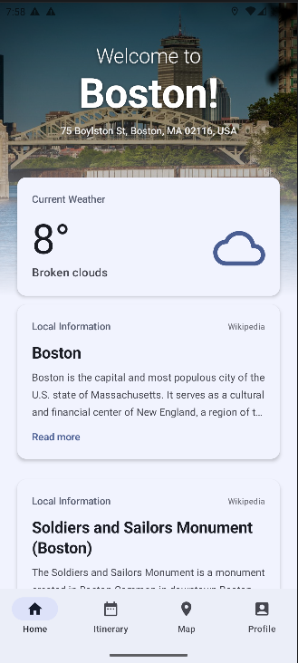
Core Features Currently Implemented
Location Information & Address
Weather information
Search & Featured Locations
Basic Itinerary Planning
Map

Slide 3



Implemented External APIs
OpenWeather API
Weather information for user location
Google Maps/Google Places API
Map and place recommendations
Wikipedia API
Place information

Slide 4
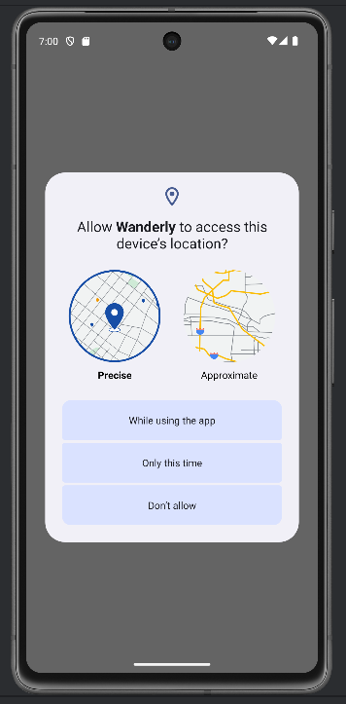
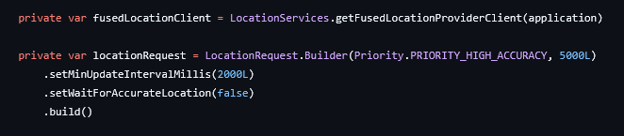
Sensors
GPS and Location Services
User location provided via FusedLocationProvider

Slide 5
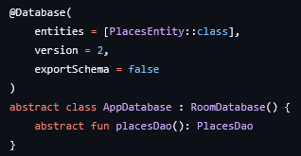
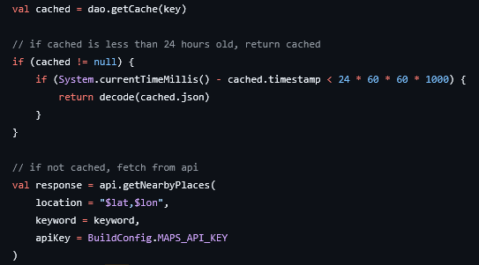
Local DB
Room
Stores place/location information in a cache
Reduce needed API calls and improve performance/speed

Slide 6
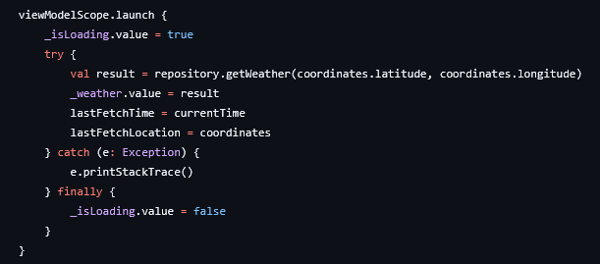

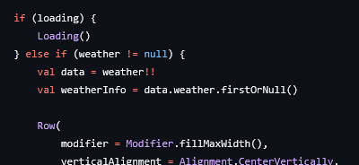
Error Handling
Try-Catch
Done within ViewModels
Used in asynchronous coroutines to gracefully deal with failed API calls
Conditionally render based on available info

Slide 7
Architecture
MVVM
StateFlow
Database Schema

Slide 8
MVVM Design
UI Elements
ViewModel
UI separated from business logic by ViewModels
ViewModels retrieve data through an intermediate Repository
Repository acts as the access point to data either by API call or local database/cache
Repository
Room
External API

Slide 9


StateFlow
WeatherViewModel
ViewModels use StateFlow to automatically update UI when state changes
WeatherCard
Underlying Composables

Slide 10
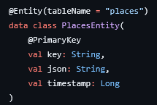
Database Schema
Only a single entity so far: PlaceEntity
Primary key made of the place’s LatLng value and query type
json for storing Place object’s info used by Google’s API
timestamp stores relevance of cached place. Cached values older than 24 hours are ignored!

Slide 11
Debugging
Emulators
LogCat
LLMs

Slide 12
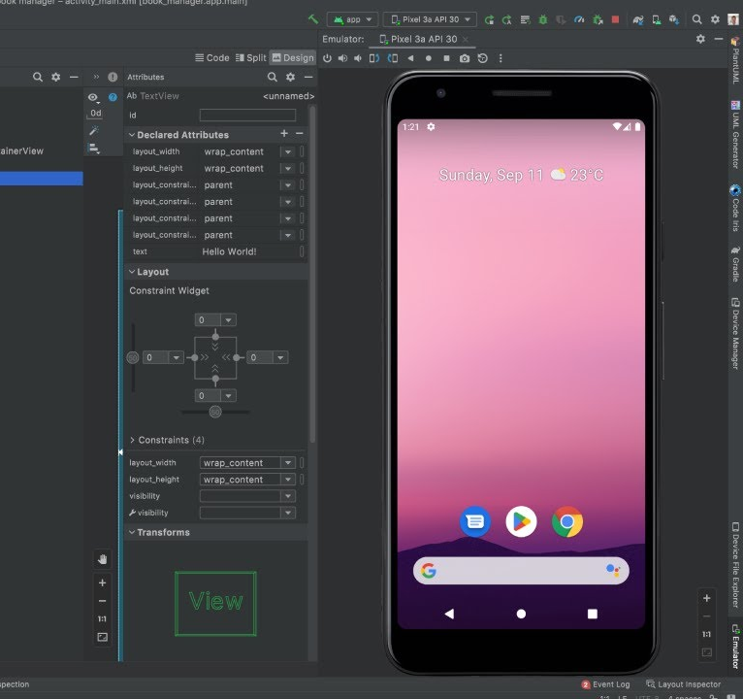
Emulator
A great deal of testing was done on an emulator
Test state persistence during reconfiguration
Test location services and GPS for app by changing emulator settings

Slide 13
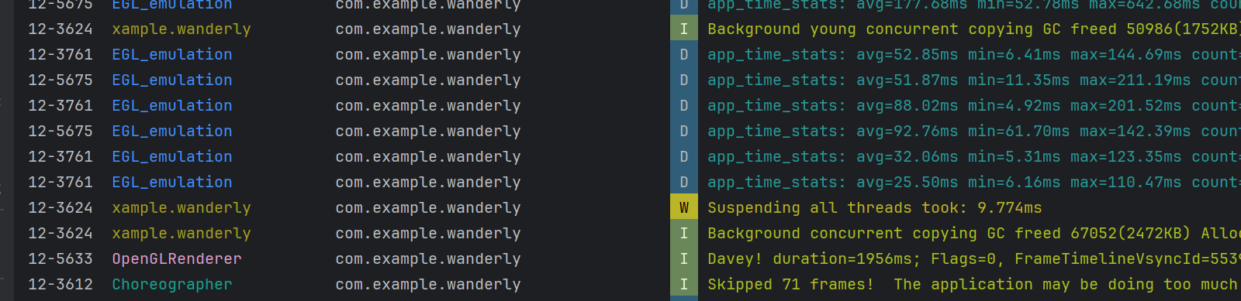
LogCat
System logs provided by a device/emulator to trace errors and messages
Log.e()
Log.d()

Slide 14


AI For Debugging
Android SDK provides Gemini companion for development
Can trace LogCat to find reasons for bugs
Provide potential solutions
Handle dependencies and versions

Slide 15
Team Workflow
Team Member | Areas of Responsibility | Key Contributions
Aidan Xu | Home Page & Maps | Developed Home Page recommendation logic, "Interesting Places" feed, and Map view integration using Google Places API.
Shrey Devkar | Itinerary Page & User Profile | Architected the entire Itinerary Planning feature (logic, state management, and UI) and the User Profile page.

Slide 16
Stretch Goals
Our initial vision for Wanderly was broad, but we have prioritized core stability and data persistence over "flashy" social features.
Status: Descoping Social Features
Decision: We have officially descoped the "Social Media" aspect (Friends lists, Public Photo Feed).
Reasoning: Implementing a secure, real-time social backend would detract from the core mission of being a high-performance personal travel assistant.
Status: In-Progress / Potential
Itinerary Export: Capability to export the planned itinerary to a PDF or calendar format.
Offline Mode: Enhancing the Room database to allow full itinerary viewing even when the user loses signal.
Advanced Filtering: Sorting recommendations by specific categories (e.g., museums vs. parks) rather than just proximity.

Slide 17
End

